Slide 1
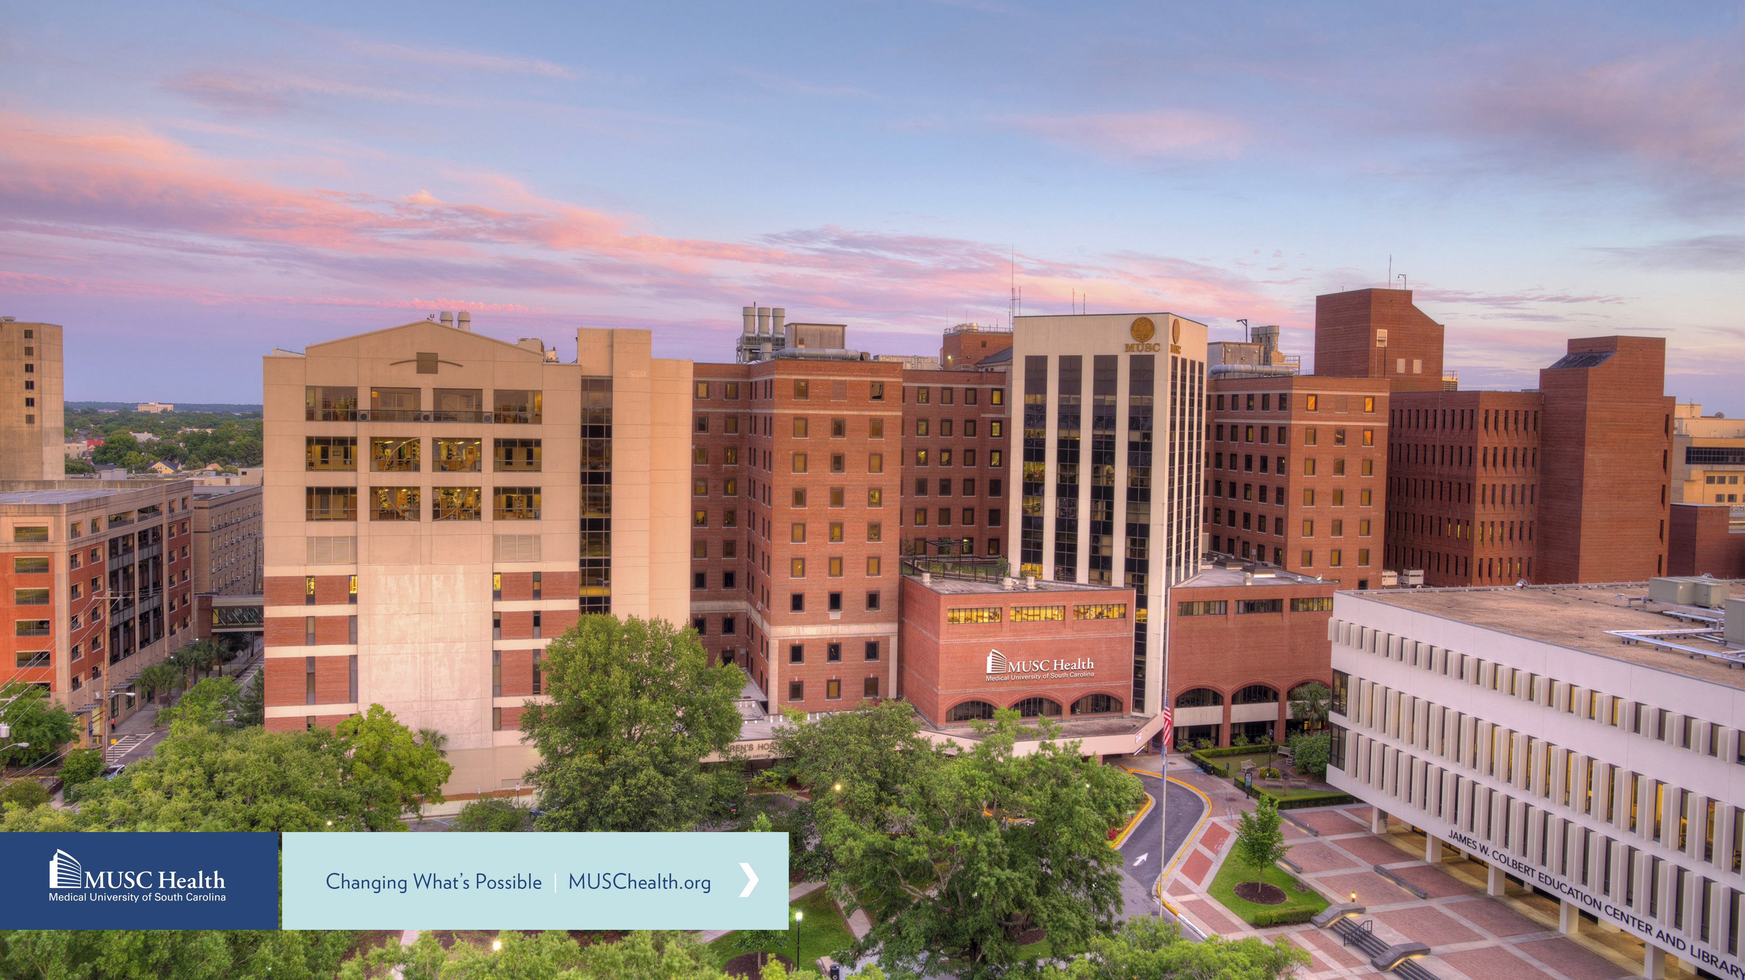
The Living Biobank
MUSC: Biomedical Informatics Center

Slide 2
Overview
Welcome to the Living Biobank!
The Living Biobank tracks availability of surplus clinical specimens for precisely e-phenotyped cohorts of patients and allows investigators to request those samples and/or resulting microbiome assay data for research use.
To get started, you should know the following:
To use the Living Biobank you are required to have completed relevant institutional and CITI trainings
You will be asked to consent to a Data Use Agreement (DUA) to initiate a request
Requests made to the LBB will result in the following:
Blood requests → Blood samples (your research team will take direct possession of samples on an ongoing basis)
Microbiome requests (nasal/perianal swabs, stool) → Assay dataset provided once your request have been fulfilled (no samples will be provided)

Slide 3
The Living Biobank and i2b2
The Living Biobank relies on i2b2 for precise cohort e-phenotyping
MUSC faculty innately have access to i2b2, however staff will require faculty sponsorship if not previously give
Completed i2b2 sponsorship forms should be sent to datarequest@musc.edu
Please be highly specific when creating your i2b2 query as it will be the source for correctly identifying samples applicable to your request
Additional information/resources on the following page

Slide 4
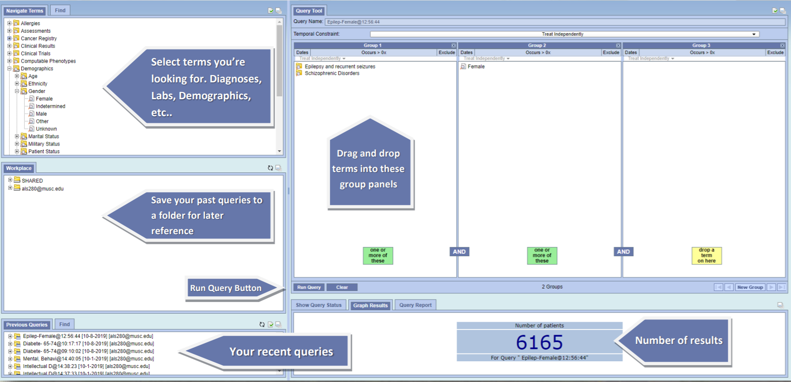
Step 1: i2b2 Query
Create i2b2 an query to identify your patient population
Detailed guidance available HERE.
Save your request with an easily identifiable name

Slide 5
i2b2 Example Query Using “Sequence of Events”
1. Create a population using “Define Sequence of Events” functionality
2. Define "Event 1"
3. Define “Event 2” (as needed)
4. Define final event where specimen recruitment takes place
5. Define “order of events”

Slide 6
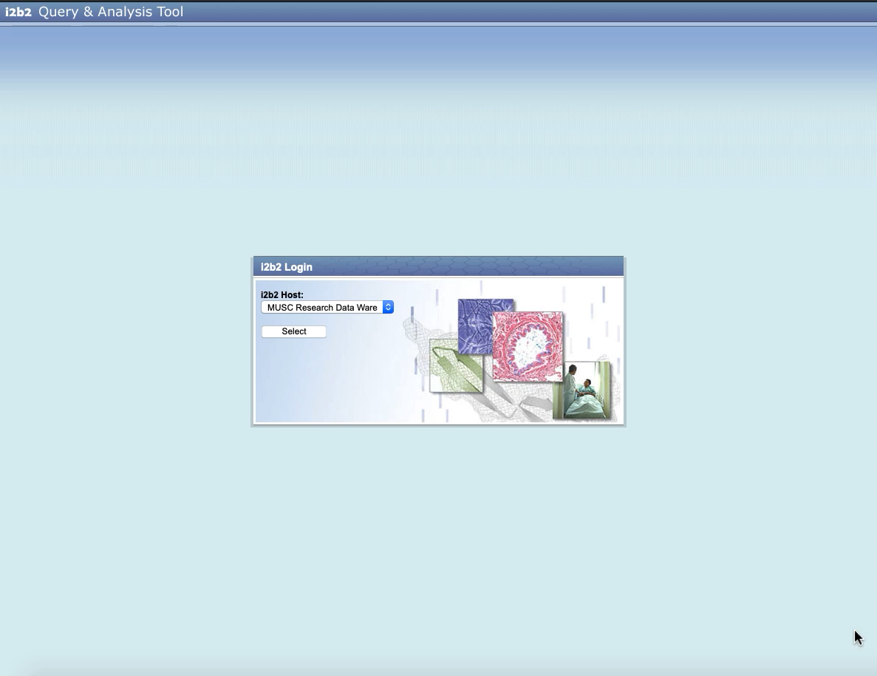
Video Demonstration of an i2b2 query for Living Biobank
1. Create a population using “Define Sequence of Events” functionality
2. Define "Event 1"
3. Define “Event 2” (as needed)
4. Define final event where specimen recruitment takes place
5. Define “order of events”

Slide 7
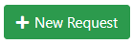
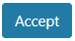
Creating a Living Biobank Request
Login to the Living Biobank with your MUSC NetID and Password
You will be directed to the “Requests” page of the Living Biobank
Your requests will be displayed and tracked here – if it is your first time visiting, this page will be blank
To start a new request, select the button in the top right corner of the screen
You will be promoted with the Data Use Agreement which is applicable to any specimens/data resulting from the Living Biobank
Please read this carefully and select if you wish to proceed

Slide 8
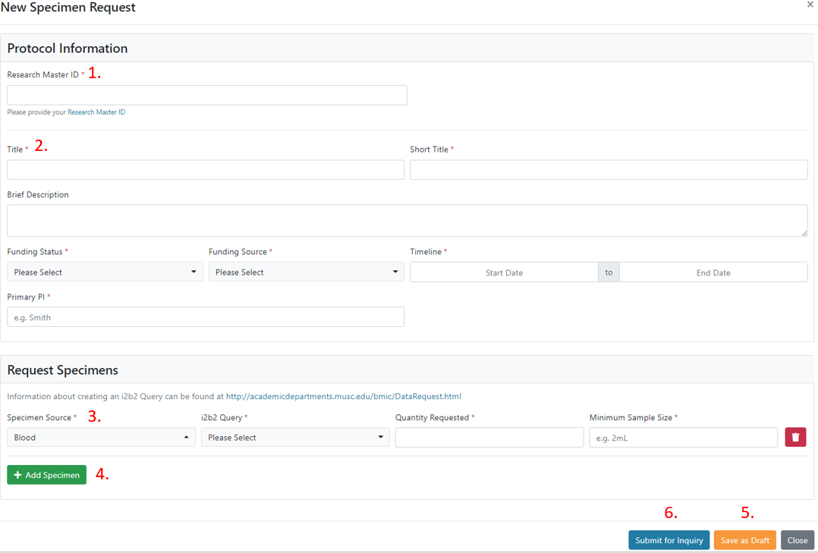
Preparing your Request
1. RMID input here – will pull protocol information from SPARC (if avail.) or create one. If you do not have an RMID you will need to create one
2. Protocol information from SPARC will populate here or can be entered if unavailable
3. Specimen request defined here – i2b2 queries associated with your NetID will be available for selection. Minimum sample size is only required for blood requests
4. Multiple sample types can be requested
5. Requests can be saved as drafts and completed/ edited later
6. Once complete the request can be submitted (if the request does not submit, check that all required information has been provided )

Slide 9

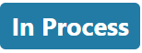
After Request Submission
After you submit your request, it will transition to a state
This means your request has been received and you should hear from BMIC’s Data Request Team within 3-business days for a consult
Data Request Consult
Confirm and/or refine your i2b2 cohort
Ensures your request accurately identifies relevant samples
Determine the need for associated clinical data
Data from the medical record/research data warehouse can be provided in association with the samples and/or microbiome assay data
More details about this service can be accessed here
Following the consult, your request will transition to and fulfillment will begin!!

Slide 10

Request Fulfillment
Fulfillment is tracked in real time and viewable from the Requests page
Daily, the Living Biobank searches for surplus clinical samples that match your request and notify our honest brokers that they are ready for pick up
Blood Fulfillment
Ongoing fulfillment:
As sample(s) become available you will be notified via email to retrieve them from our honest broker’s lab located on the 7th floor of the Basic Science Building in the Hollings Cancer Center Biorepository, room BS739
The Lab is open 9AM to 5PM and you will have until noon the day after the sample is released to pick it up – otherwise it will be discarded
Please be prepared to bring a lidded container and gloves for the pick up
Associated data requests are fulfilled after all samples have been collected
Microbiome Fulfillment (Nasal/Perianal Swabs and Stool)
Bulk fulfillment:
Though tracked in real time, requests associated with microbiome samples are fulfilled once all samples have been collected
Samples are collected, stored, then batch analyzed to generate the final assay dataset
Associated data requests are also fulfilled after all samples have been collected
Samples are not directly provided for microbiome requests

Slide 11



Questions?
Contact us a livingbiobank@musc.edu

